Slide 1
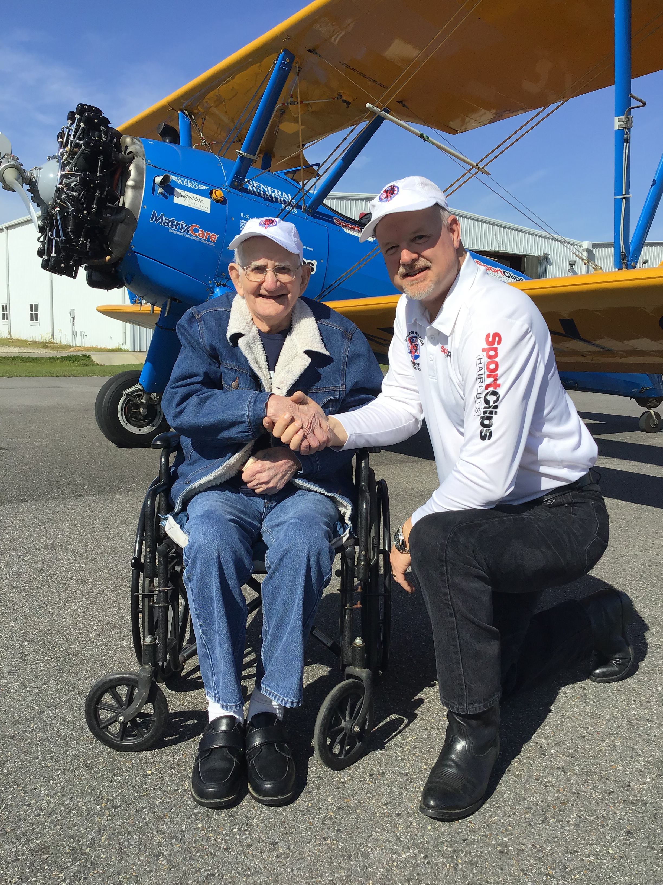
Give back to those who gave

Slide 2
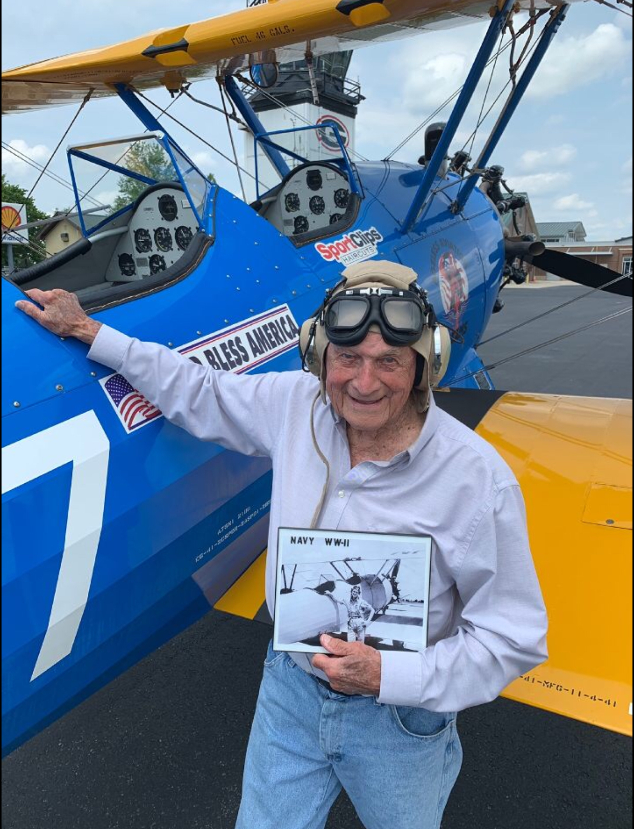
Dream Flights
Dream Flights is a non-profit 501c3 organization founded in 2011
Our mission is to give back to those who gave.
We are dedicated to honoring seniors and military veterans.
We provide Dream Flights nationally in 6 Boeing Stearman biplanes.
We’ve flown over 4,200 Dream Flights in 41 states including Alaska.

Slide 3
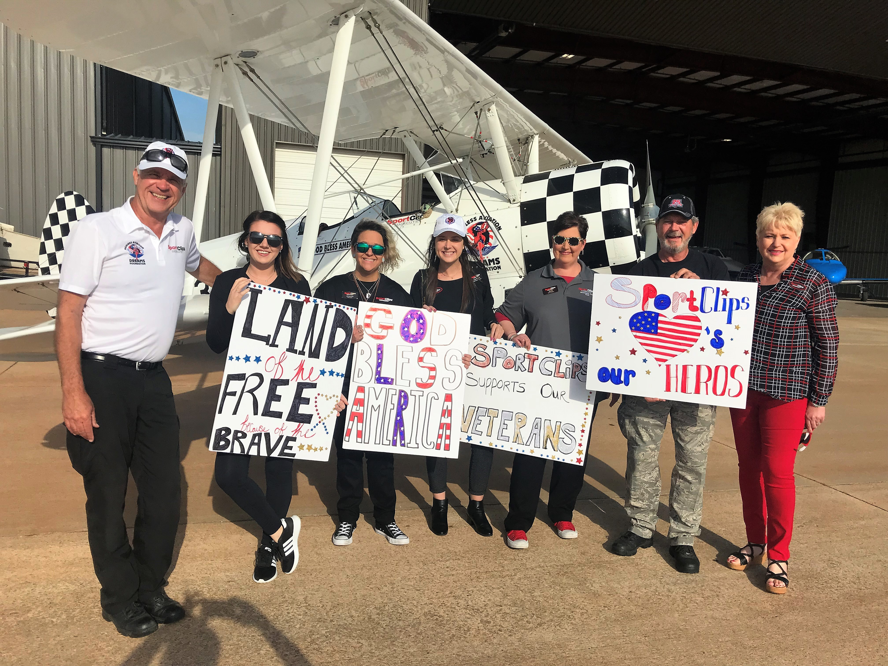
Dream Flights
Key partners include:
SportClips
American Airlines
American Health Care Association, etc.

Slide 4
Direct Supply Connection

Slide 6
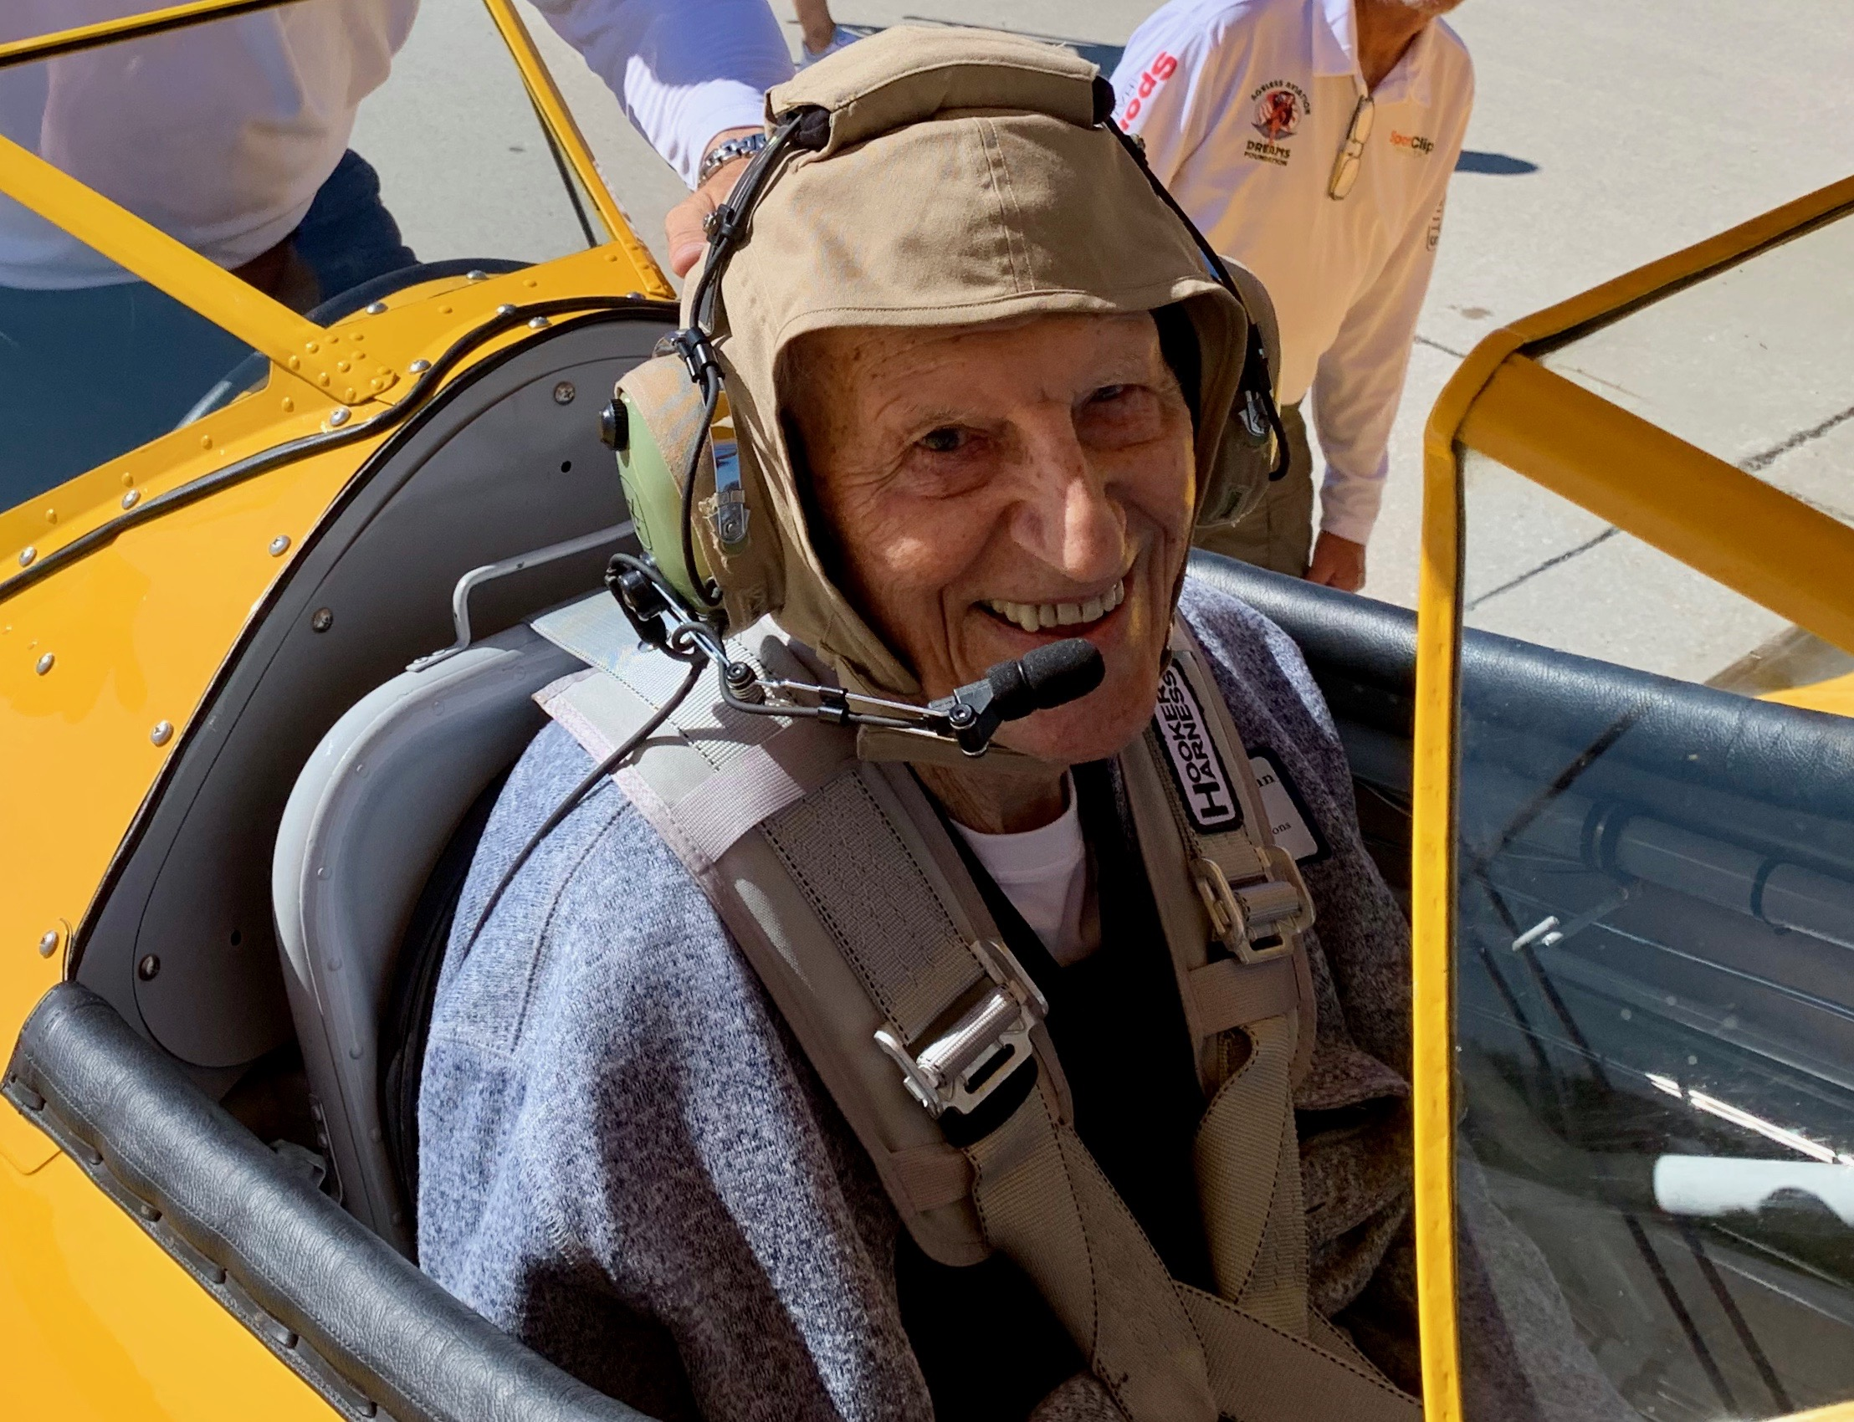
Scope
Last national recognition for WWII veterans
We estimate over 1000 WWII veteran Dream Flights
Largest ever national barnstorming effort
Six airplanes flying every day for 61 days
We will touch over 300 cities

Slide 8
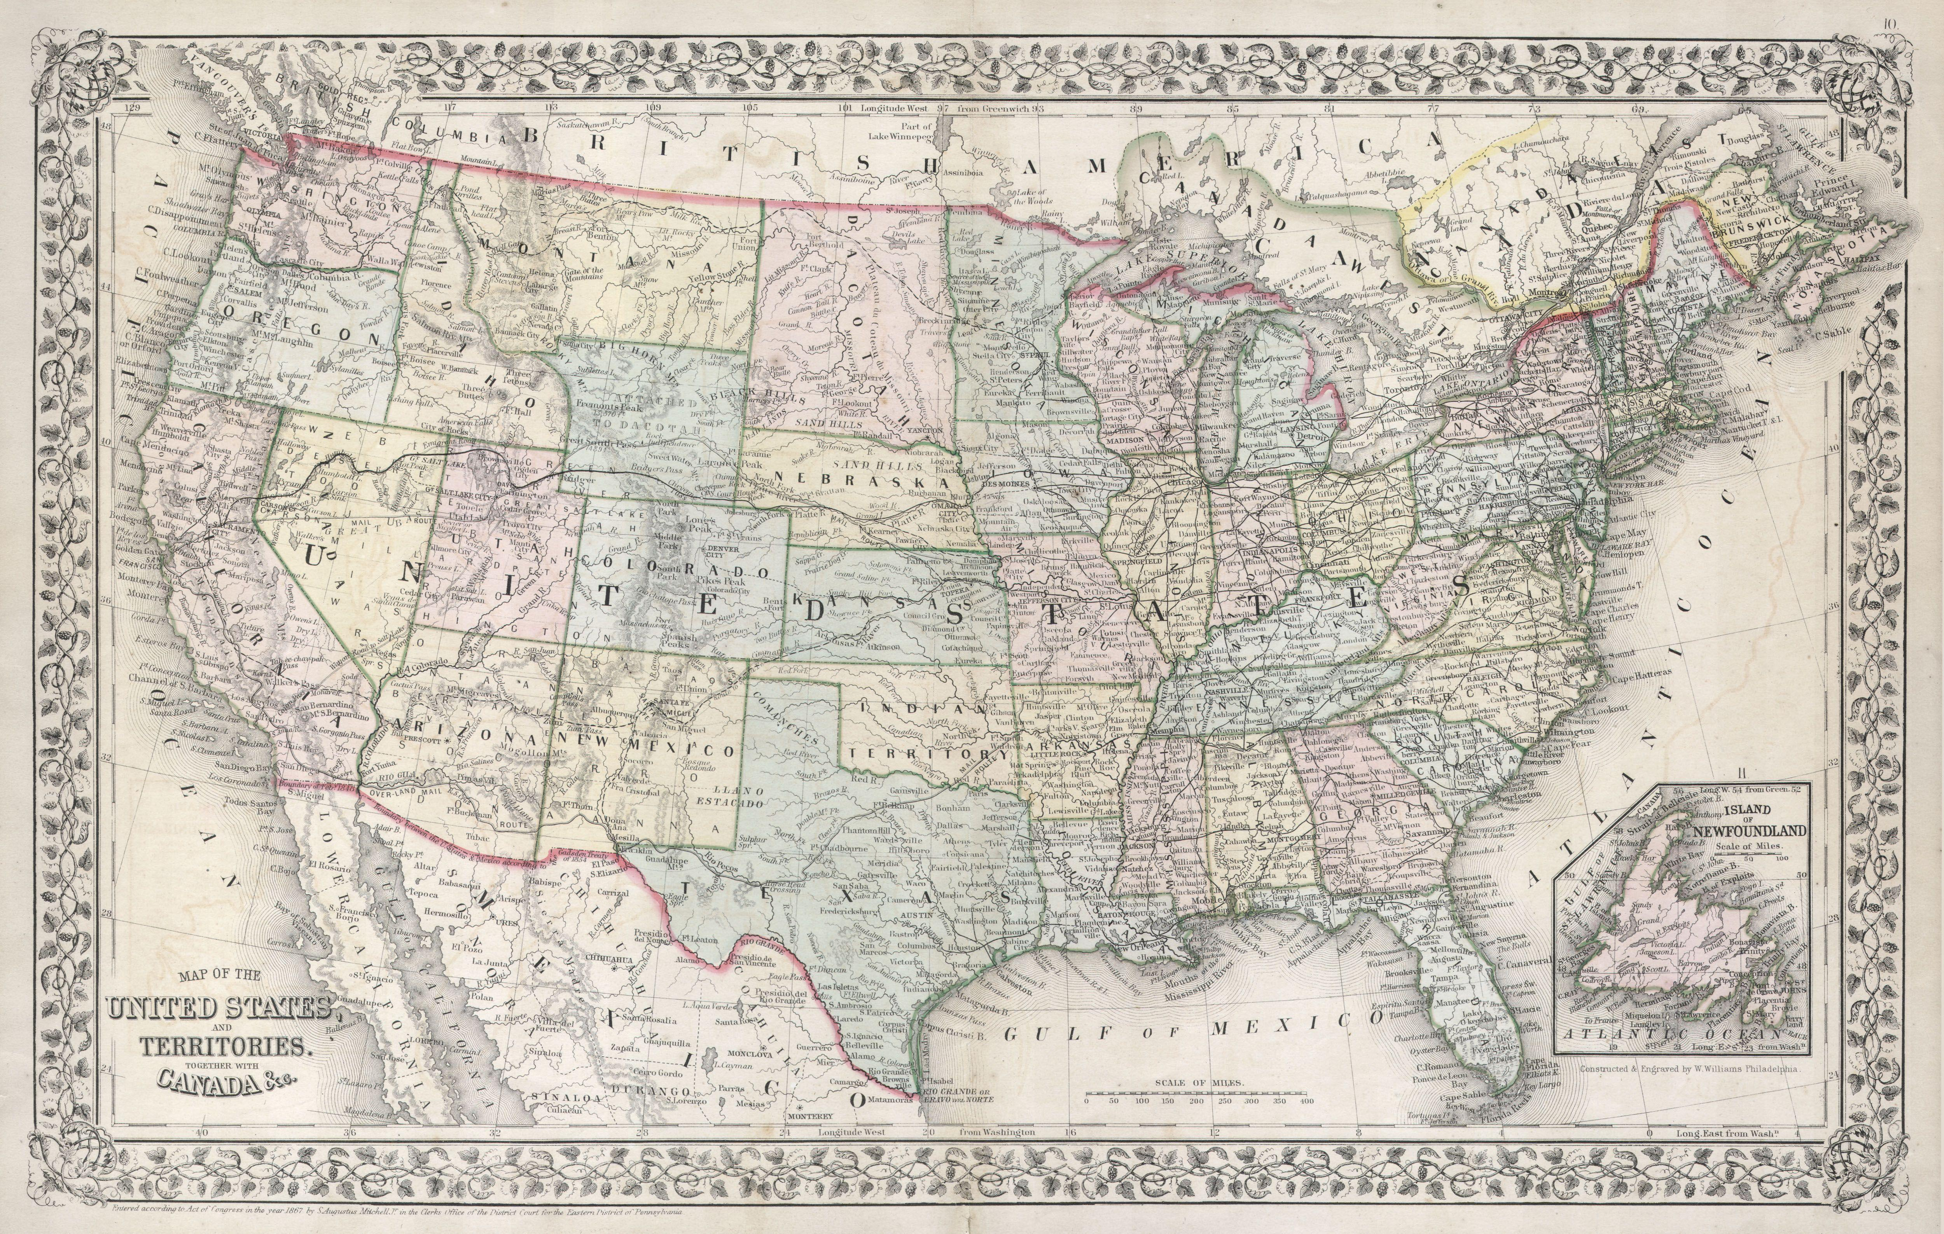

Slide 9
Milestones
April and May – collect WWII veteran applications on our website: www.dreamflights.org/honor/
June 1 – Final cut off for applications
June 30 – Route each plane will fly is set
July 15 – First week of August events set
August 1 – Operation September Freedom Begins!
September 30 – Final Dream Flight events conclude

Slide 10
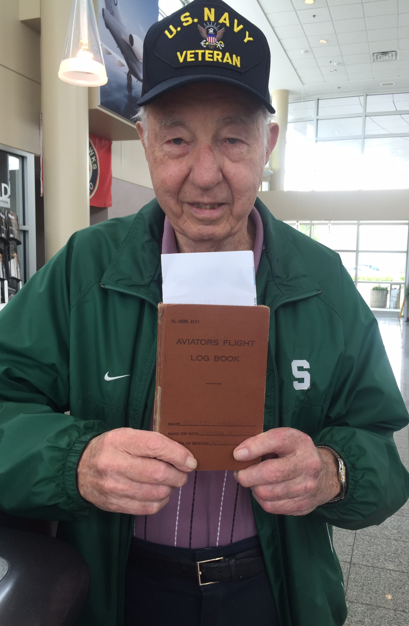
Dream Flights – VFW partnership
VFW Program Director Lynn Rolf is on our communication’s team
Find WWII veteran dream flyers
Fundraise – Encourage VFW members to participate in this historic event
Come out to the events and celebrate our WWII heroes
Use Social Media channels to tell the WWII veterans stories

Slide 11
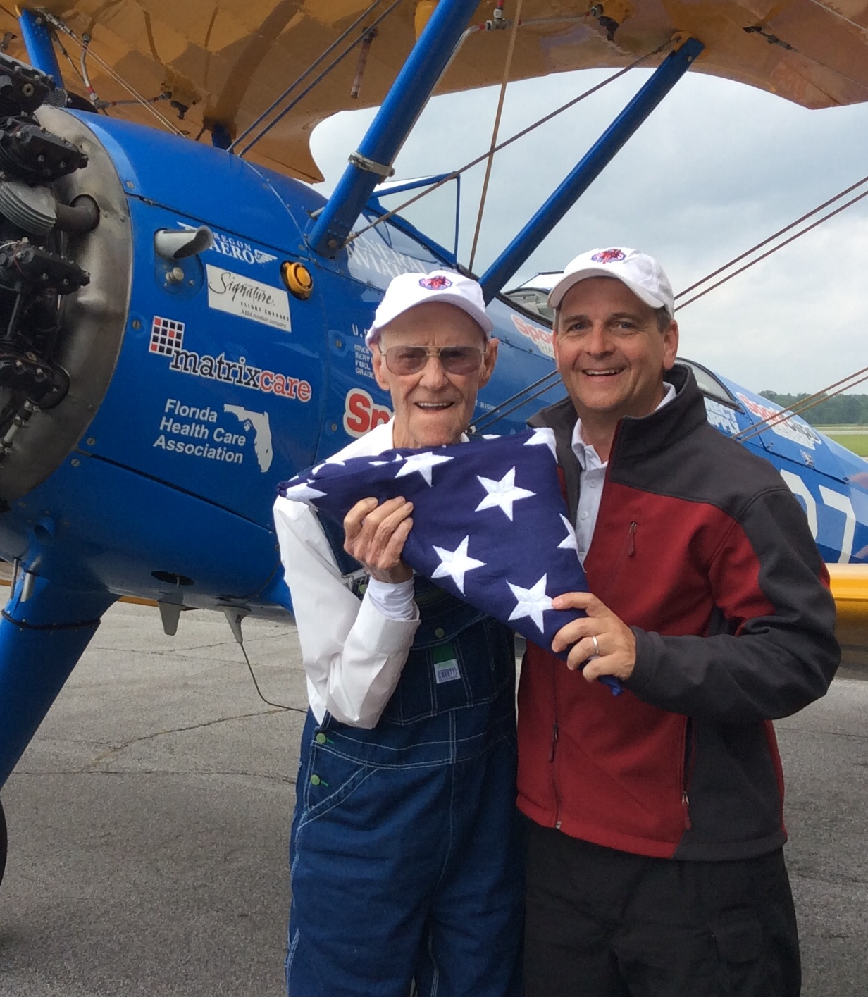
Thank you!
We’re grateful for the opportunity to partner with you.

Slide 12
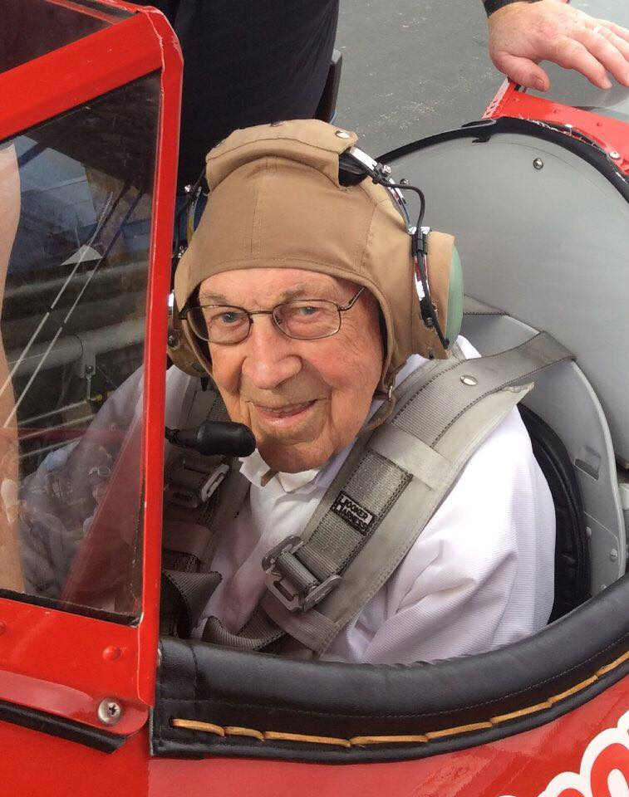
Contact Information
Website - www.dreamflights.org
Darryl Fisher, President – darrylf@dreamflights.org, 775-737-8906
Merilyn Chaffee, VP of Operations – merilync@dreamflights.org, 707-738-0916
Facebook, dreamflightsorg
Instagram, @dreamflightsorg
Youtube, Dream Flights

